Slide 1
Hyper Text Mark up Language
HTML

Slide 2
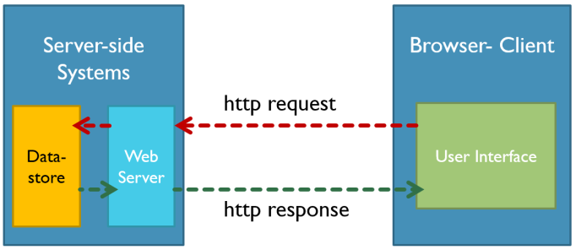
Request-Response
Wide Web traffic mostly uses the HTTP protocol because HTTP uses the
most bandwidth across the Internet.
HTTP (Hyper Text Transfer Protocol) as a protocol designed to allow the
transfer of Hypertext Markup Language (HTML) documents.

Slide 3
HTTP takes care of the communication between a web server and a web browser. It first establishes a secure connection between a server and a browser.
Client that is running an application on the web browser can send requests to the connected server and upon request, the
server sends data that reside on a repository or a datastore to the client

Slide 4
Html Structure
<!doctype html>
<html>
<head>
<meta charaset="UTF-8">
<meta name="viewport" content="width=device-width,intial-scale=1.0">
<title>Html document</title>
</head>
<body>
content of web page
</body>
</html>
tags : angular brackets.
element : text from opening tag to closing tag.
atributes : additional information of the element.

Slide 5
Heading tag and Paragraph tag
1. Heading tags
<h1> </h1>
<h2> </h2>
<h3> </h3>
<h4> </h4>
<h5></h5>
<h6> </h6>
2.Paragraph tag
<p> </p>
<pre> </pre>

